Slide 2
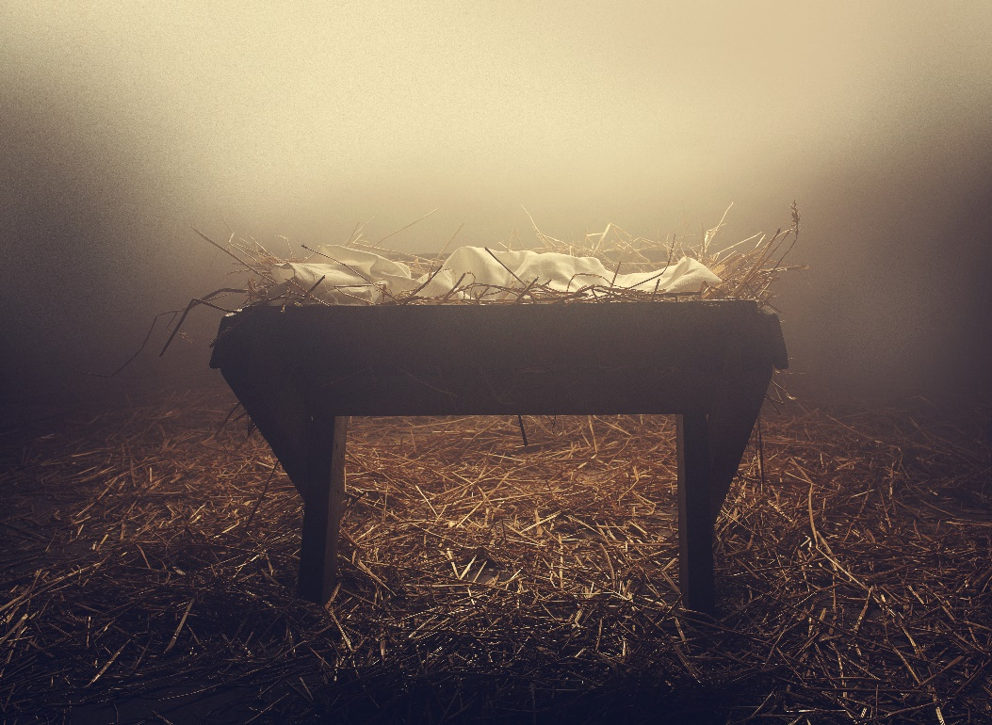
The Savior King
A Christmas Prophecy
Isaiah 9:6-7
Notes:
Isaiah gives a description of the coming Savior King, a child to be born and a son to be given, He is the God/Man, the King of Kings. He will be called Wonderful Counselor, Mighty God, Everlasting Father, Prince of Peace. He will rule a Kingdom free of confusion, chaos, complexity, and conflict. His kingdom will endure forever there will be no end to His Kingdom. He will rule this Kingdom on the earth in Jerusalem sitting on David’s throne. He is the King of David, the king of Israel. His kingdom will be characterized by justice and righteous for all time. The increase of His governing and peace will never end. And the Lord is very determined to bring this about.

Slide 3
The Savior King
A Christmas Lineage
Matthew 1:1-17
Notes:
The Purpose of this section is to show that Jesus “Yahweh Saves” had a claim to the throne of Israel through His Messianic ancestry. Matthew gives evidence that Jesus inherited the legal right to rule through stepfather Joseph. Jesus could claim the right to kingship because He was the son of David, king of Israel.

Slide 4
The Savior King
Prophets
Predicted a Literal, Tangible, Earthly, Davidic Kingdom
Jewish Nation
Expected a Literal, Tangible, Earthly Davidic Kingdom
Jesus/Disciples
Early Church

Slide 5
The Savior King
Jews
Expect a Literal, Tangible, Earthly Davidic Kingdom
Christians
TLBC
The Literal, Tangible, Earthly Davidic Kingdom is also Spiritual
The Child that was conceived was by the Holy Spirit” (1:20)

Slide 6
The Savior King
Jews
Expect a Literal, Tangible, Earthly Davidic Kingdom
Christians
TLBC
The Literal, Tangible, Earthly Davidic Kingdom is also Spiritual
“The Spirit of the Lord God is upon Me, because the Lord has anointed Me…” (Isa. 61:1; 42:2) and was lead by the Spirit (Lk. 4:1).
Notes:
The entire NT is very spiritual, in fact the word “spirit” is used 349 times. The NT is also very earthly. The word “earth” is used 182. Revelation is more “earthly” than it is “spiritual. “spirit” is used 15 times, but “earth” is used 72 times, more than any NT book.

Slide 7
The Savior King
A Christmas Fulfillment
The Virgin Birth
Matthew 1:18-25
Notes:
The fact that Jesus was born “of Mary” only as indicated in the genealogical record (1:16) demands further explanation. How is it that Joseph is merely the husband of Mary, but not the father of Jesus?
Although Jesus is a legal descendent of King David through Joseph, Jesus is no ordinary King. He is human proved by His human ancestry, but is also divine, as demonstrated by His names “Jesus” and “Immanuel” and manner of His miraculous conception as this section points out.

Slide 8
The Savior King
A Christmas Fulfillment
Visitors and Villains
Matthew 2:1-23
Notes:
We see in this story visitors who come from a far to worship the King of David while some nearby were villains who sought to destroy Him. The visitors came bearing gifts fit for the King, while the villains came bearing a sword fit for execution. The King came to His own but His own did not receive Him (Jn. 1:11) In the end His own even sought to destroy Him (12:14; 27:20). And so they finally did destroy Him by hanging Him on a cruel cross. The victory was theirs, so the villains thought.
Three days later some women came seeking to visit the tomb of the One who had been crucified, the King of the Jews, but they were told by an angel that He was not there, He had risen from destruction. . And then He Himself appeared to the woman and they fell at his feet and worshipped Him, rejoicing! He then appeared to His disciples and they worshipped Him.
Matthew begins with representatives of the nations coming to the King bearing gifts, but Matthew ends His story with the King sending representatives of His to the nations bearing the gift of eternal life.
Today, wise men still seek to worship Him, while vile men still seek to destroy Him, until the King’s return to destroy all that is vile and to establish His glorious Kingdom.

Slide 9
The Savior King
The Search for the Child
Matthew 2:1-10
A Fulfilment of Balaam’s Prophecy and from the Prophet Micah

Slide 10
The Savior King
“Now after Jesus was born in Bethlehem of Judea in the days of Herod the king, behold, wise men from the East came to Jerusalem, saying, "Where is He who has been born King of the Jews? For we have seen His star in the East and have come to worship Him.” (2:1-2)

Slide 11
The Savior King
“Now after Jesus was born in Bethlehem of Judea in the days of Herod the king, behold, wise men from the East came to Jerusalem…” (2:1)
“wise men” [NKJV, KJV, RSV]
Literally - “magi” [NASB; NIV]
Notes:
The exact identity of the magi is impossible to determine.
“magi”, a Persian word, we get the words “magic” and “magistrate”. Some say they represent the three groups of peoples that descended from the three sons of Noah, Shem, Ham, and Japheth. Most believe their three of them because they brought three gifts. There were probably many more, they probably did not ride on camels but on horses. They were not kings themselves, but at most magistrates, ruling advisors. John MacArthur suggest that they were king makers, those who coronet/crown “anoint” the kings. They came to “anoint” the “anointed One”.

Slide 12
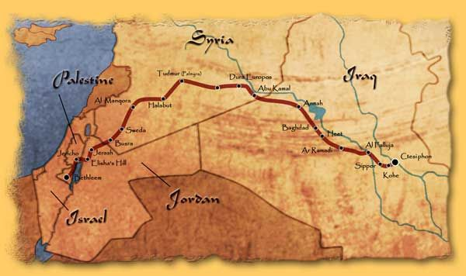
The Savior King
Notes:
The magi came from the east, that is, east of Jerusalem, and probably traveled this route. They most likely first saw the star at the birth of Christ, then taking several months to travel the distant so that at the time of their arrival they find a child in a house, not a infant baby in a manger of a stable.

Slide 13
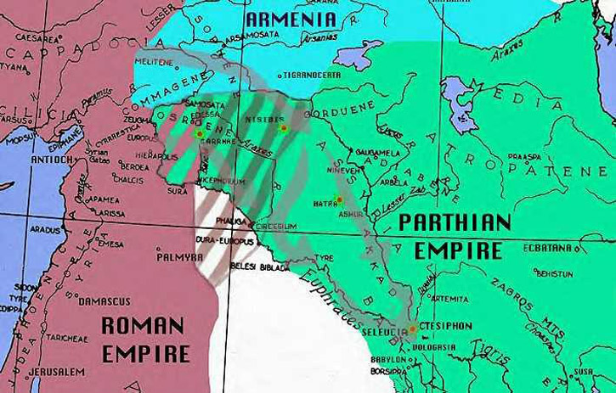
The Savior King
Notes:
The magi probably came from the Parthian Empire, a revival empire of Rome. The Romans were defeat in a major battle around 50 BC by the Parthians. Alexander the Great had conquered this area previously the remnants of the Persian Empire. It was ruled by the Seleucia Greeks for several centuries, and was never conquered by Rome. Many Jews remained in the area after the dispersion and the return. The magi would have been exposed to Old Testament Scripture prophecies. Their comments reflect a knowledge of Balaam’s prophecy concerning, the “star” that would “come from Jacob” (Num. 24:17). They may have also been familiar with Isaiah prophecy concerning the birth of a child that would rule over His Israel and Judah.

Slide 14
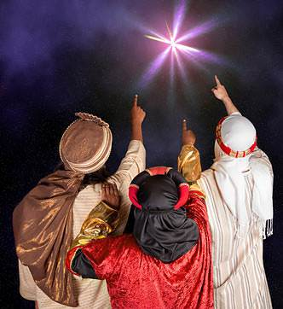
The Savior King
“…saying, ‘Where is He who has been born King of the Jews? For we have seen His star in the East and have come to worship Him.” (2:2)
Notes:
After losing sight of the star, they traveled to the logical place where a Jewish king would be born – to the capital of Israel, Jerusalem. They expected to find the king in the capital city, recognized, acknowledged, surrounded, and worshipped. They came to the court of Herod the King and to their surprise they find the nation unaware of His arrival, an indifferent religious priesthood, and a civil ruler who was hostile to such a king.

Slide 15
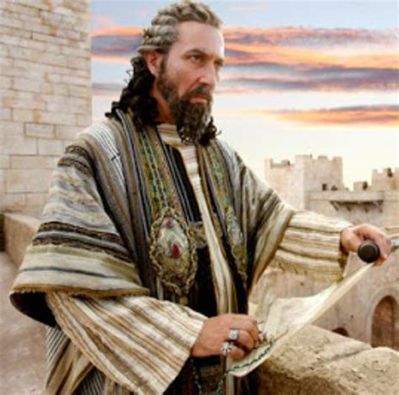
The Savior King
“When Herod the king heard this, he was troubled, and all Jerusalem with him.” (2:3)
Declared “King of the Jews” by Rome.
Herod was an Edomite.
Shock waves.
Notes:
It is no surprise that King Herod would be troubled, disturbed and shaken like a rolling sea and the city as well. In 37 BC the Romans, at the urging of Marc Anthony and Octavian, proclaimed Herod the Great, “King of the Jews”. Herod’s father assisted the Romans in defeating in the Hasmoneans in 63 BC who ruled the Palestine for nearly 103 years, sometimes back by the Parthian Empire.
Herod was an Idumean (Greek word of Edomite) a descendent of Esau, Jacob’s older brother, who were at odds with each other. It was said that the older Esau would serve the younger Jacob. At the time of Christ’s birth the opposite was true. Herod had no physical or legal right to rule over the Judeans. This was why he was not particularly liked, but hated by the Jews, even though he did much for the country.
“So the presence of a large and impressive caravan from the Parthian Empire, an enemy of Rome, arriving to worship a newborn Jewish King would have sent shock waves throughout the city.” (Grace Commentary, p.14) The fact that the Jews had never truly accepted him as their king, and someone who was rightly born king appeared, then Herod’s job and life was in jeopardy.

Slide 16
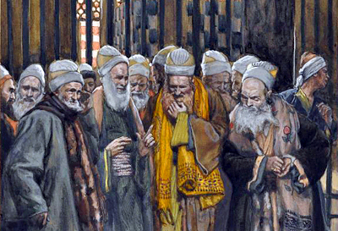
The Savior King
“And when he had gathered all the chief priests and scribes of the people together, he inquired of them where the Christ was to be born.” (2:4)
Notes:
Herod called the Jewish scholars together to inquire where “the Christ [Anointed One] was to be born”. Herod connected the One “born King of the Jews” with the Messiah, “the Christ”. Israel had a expectation of a messianic hope of a deliver who would save His people and believed that the “Anointed One” would be born. But where?

Slide 17
The Savior King
“So they said to him, ‘In Bethlehem of Judea, for thus it is written by the prophet: ‘But you, Bethlehem, in the land of Judah, are not the least among the rulers of Judah; For out of you shall come a Ruler Who will shepherd My people Israel.” (2:5-6)
Notes:
The magi made aware of the King’s arrival, the chief priest and the scribes make him aware of where He was to be born. They inform Herod from Micah 5:2 that the Messiah’s birthplace was Bethlehem of Judah, the city of King David. They also inform him that His rule would be like a shepherd (5:4). He will be a Shepherd-King who would protect and care for Israel, and defeat her enemies.

Slide 18
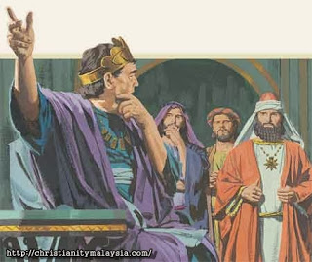
The Savior King
“Then Herod, when he had secretly called the wise men, determined from them what time the star appeared.” (2:7)
Notes:
To eliminate the threat Herod meets secretly with the magi to determine how long ago the star appeared. This shows that Herod was already thinking of a plan to get rid of this young king.

Slide 19
The Savior King
“And he sent them to Bethlehem and said, ‘Go and search carefully for the young Child, and when you have found Him, bring back word to me, that I may come and
worship Him also.” (2:8)
Notes:
He deceitfully tells them he wants to also worship this newborn king, but has no intention of doing so. Not to blow his cover Herod request the magi carefully seek out the young Child in Bethlehem and inform him of His whereabouts, so that he may destroy Him.

Slide 20
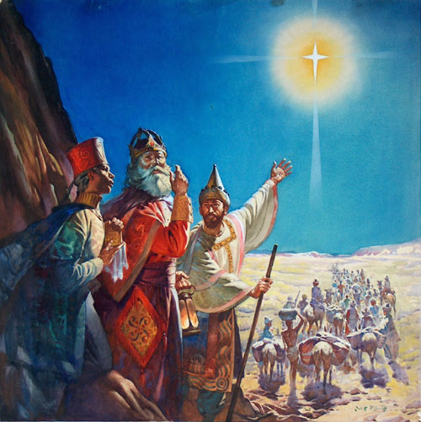
The Savior King
“When they heard the king, they departed; and behold, the star which they had seen in the East went before them, till it came and stood over where the young
Child was. (2:9)
Notes:
When they left Jerusalem for Bethlehem, just 5 miles south, the star reappears. It was the same star that they had seen in the east, but this time it would have appeared to their south. “It moved and remained over the house (2:11), not the stable, where the Child was, not the infant baby.

Slide 21
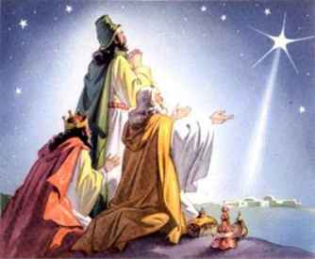
The Savior King
“When they saw the star, they rejoiced with exceedingly great joy.” (2:10)
“star” the language of appearance.
“star”- the “Shekinah Glory of God”
Notes:
“the star” was the language of appearance, a figure of speech, like a “sunrise”.
Many suggest that the star was actually the “Shekinah glory of God”. The same glory and light that lead the Israelites through the wilderness. It may have been the same glory that appeared to the shepherds when “the glory of the Lord appeared around them” (Lk. 2:9) The magi did not just simply rejoice, but they rejoiced with exceeding great joy! They probably began singing… “How great our Joy! Joy, Joy, Joy! Praise we the Lord in heaven on high!

Slide 22
The Savior King
The Adoration of the Child
Matthew 2:11-12
A Fulfilment from the Prophets Isaiah, Zephaniah, and Haggai
Notes:
When they come to the house and seeing the Child to fulfill what they had come so far to do, that is, to worship Him. And in doing so they also fulfill the prophecies of Isaiah, Zephaniah, and Haggai.

Slide 23
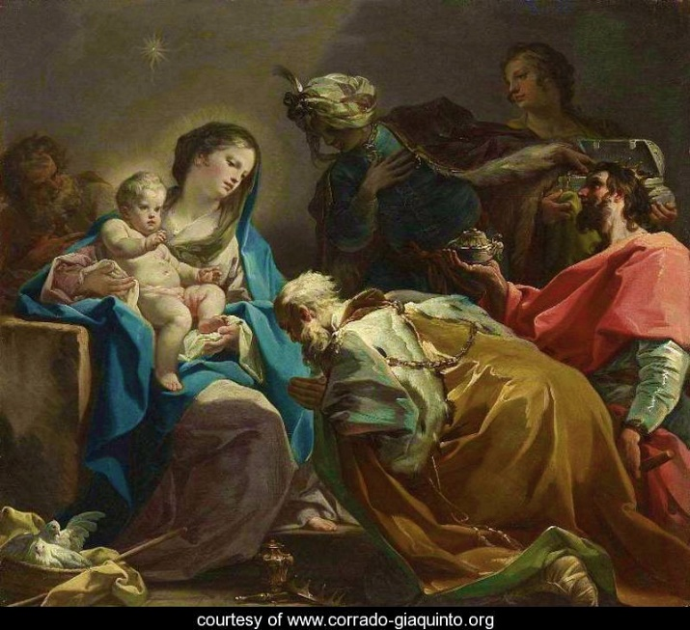
The Savior King
“And when they had come into the house, they saw the young Child with Mary His mother, and fell down and worshiped Him. (2:11a)
Notes:
They “fell down” prostrating themselves to the Child, thereby submitting to His authority as King.
Did they “worshipped Him” as God or just as a king? Did they know what was written… that they were to worship the LORD only?

Slide 24
The Savior King
“Then Jesus said to him, ‘Away with you, Satan! For it is written, 'You shall worship the Lord your God, and Him only you shall serve.” (4:5)
“You shall fear the Lord your God and serve Him…” (Deut. 6:13) “…for you shall worship no other god” (Exod. 34:11)

Slide 25
The Savior King
“Then Jesus said to him, ‘Away with you, Satan! For it is written, 'You shall worship the Lord your God, and Him only you shall serve.” (4:5)
“You shall not make for yourself an idol… You shall not bow down to them or worship them;” (Ex 20:4-5) [NIV]
Notes:
Did they know what was written… that they were to worship the LORD only?
If they had not previously it seems they knew it then. What happened to the magi? I read that some believe they were believers and established a community of believers from where they return. It is said the Macro Polo visited their tombs, or that their bones are in a chest in a church in a city in Italy to this day.

Slide 26
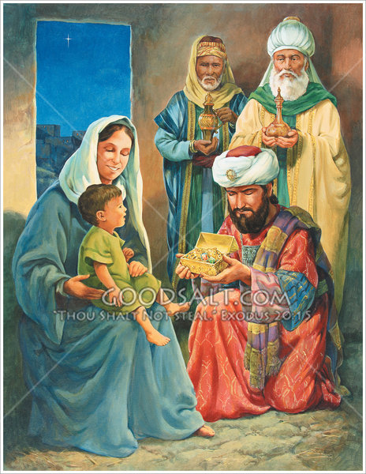
The Savior King
“And when they had opened their treasures, they presented gifts to Him: gold, frankincense, and myrrh.” (2:11b)
Notes:
Their worship was heighted by the giving of gifts worthy of a prophet, priest and king.

Slide 27
The Savior King
“And when they had opened their treasures, they presented gifts…”
Gold – fitting for a King.
Frankincense – sweet perfume used by priests.
Myrrh – for those who were about to suffer and die, like the prophets.
Notes:
These Gentile magistrates and their gifts represent the wealth of the nations.

Slide 28
The Savior King
“The wealth of the Gentiles shall come to you… They shall bring gold and incense, and they shall proclaim the praises of the Lord… That men may bring to you the wealth of the Gentiles, and their kings in procession.” (Isaiah 60:5-6, 11)
Notes:
The coming of the magi prefigure the ultimate time when the nations come under His rule.

Slide 29
The Savior King
“From beyond the rivers of Ethiopia My worshipers, the daughter of My dispersed ones, shall bring My offering.” (Zephaniah 3:10)
“'I will shake all the nations; and they will come with the wealth of all nations, and I will fill this house with glory,' says the Lord of hosts.” (Haggai 2:7) [NASU]
Notes:
The coming of the magi prefigure the ultimate time when the nations come under His rule.

Slide 30
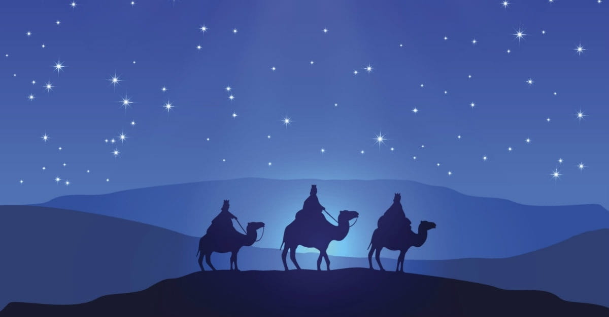
The Savior King
“Then, being divinely warned in a dream that they should not return to Herod, they departed for their own country another way.” (2:12)
Notes:
God warned the magi in a dream not to have any further contact with the villain King Herod. So they departed from traveled back east and certainly must have told someone of their story, though the visitors from the east are never heard of again. But they did their part.

Slide 31
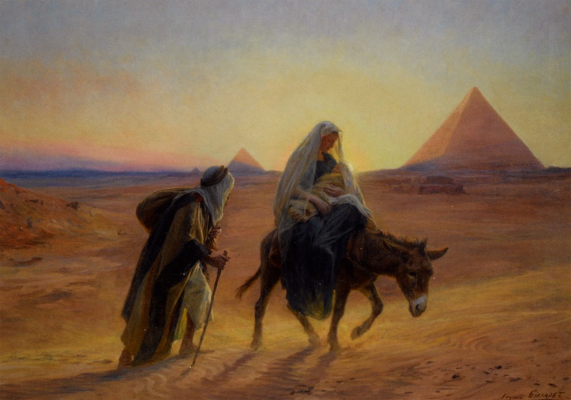
The Savior King
The Flight of the Child
Matthew 2:13-15
A Fulfilment from the Prophet Hosea

Slide 32
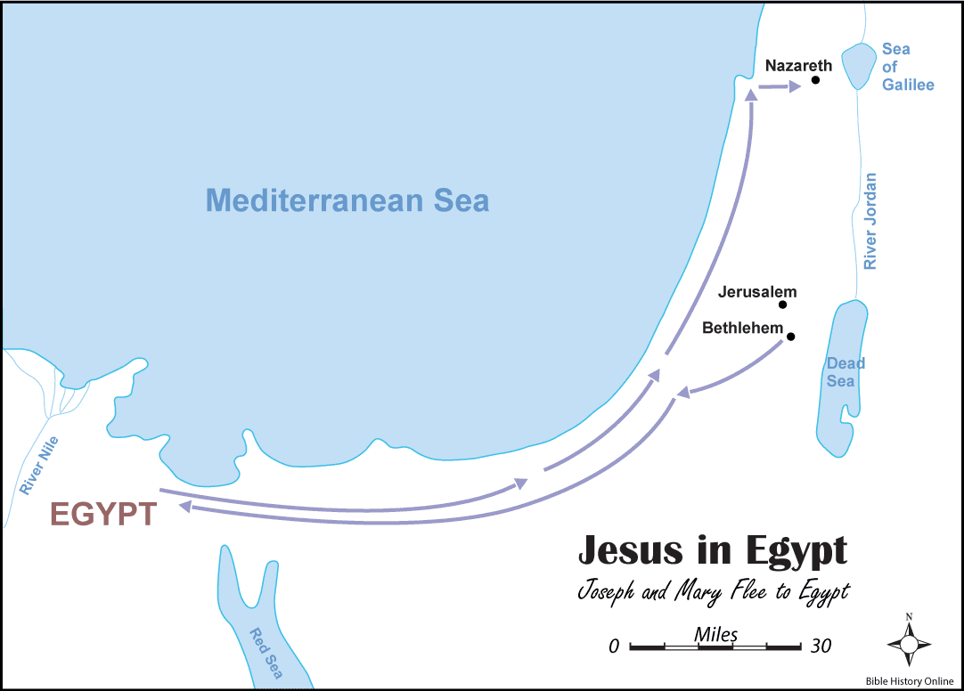
The Savior King

Slide 33
The Savior King
“Now when they had departed, behold, an angel of the Lord appeared to Joseph in a dream, saying, ‘Arise, take the young Child and His mother, flee to Egypt, and stay there until I bring you word; for Herod will seek the young Child to destroy Him.” (2:13)
Notes:
This would be the second time an angel appears to Joseph in a dream. There would be a total of four (1:20; 2:13; 19; 22). The reason for fleeing was that the villain Herod was seeking to destroy the young Child. This would not be the last time villains sought to destroy the King.

Slide 34
The Savior King
“Then the Pharisees went out and plotted against Him, how they might destroy Him” (12:14)
“But the chief priests and elders persuaded the multitudes that they should ask for Barabbas and destroy Jesus.” (27:20)

Slide 35
The Savior King
“When he arose, he took the young Child and His mother by night and departed for Egypt, and was there until the death of Herod, that it might be fulfilled which was spoken by the Lord through the prophet, saying, ‘Out of Egypt I called My Son.’” (2:14-15)
Notes:
Under the cover of darkness Joseph immediately obeyed, taking his family from Bethlehem to Egypt and remains there until the death of King Herod the Great.
Why Egypt? It was to fulfill the prophecy of Hosea 11:1b, “Out of Egypt I called My Son” In its original OT context “My Son” refers to Israel, God’s adopted child. It looks backwards to the nation of Israel, not forward to the Messiah”. The calling out of Egypt refers to the Exodus.
There were similarities between the nation and the Son. Israel was God’s chosen son by adoption (ex. 4:22) and Jesus is the Messiah, God’s Son. In both cases the flight was to escape danger and destruction.
“Matthew draws a correlation between what happened to God’s national son (Israel) and God’s messianic Son (Jesus). Both have a special familial relationship to God endowing them with His protective care… Israel is a type of God’s Son who was yet to come. A “type” is a literal historical event that prefigures a future corresponding reality.” (Grace Commentary, p. 15)
“While Hosea’s statement was a historical reference to Israel’s deliverance, Matthew related it more fully to the call of the Son, the Messiah, from Egypt. It that sense Matthew “heightened” Hosea’s words to a more significant event– the Messiah’s return from Egypt” to the promised land.” (The Bible Knowledge Commentary, p. 22-23)

Slide 36
The Savior King
The Destruction
of the Child
Matthew 2:16-18
A Fulfilment from the Prophet Jeremiah
Notes:
God was one step ahead of Herod, then Herod acts.

Slide 37
The Savior King
“Then Herod, when he saw that he was deceived by the wise men, was exceedingly angry; and he sent forth and put to death all the male children who were in Bethlehem and in all its districts, from two years old and under, according to the time which he had determined from the wise men.” (2:16)
Notes:
Herod becomes very anger once he discovered he was out foxed by the magi. He sends forth his soldiers to murder all the male children in Bethlehem and the surrendering suburbs. This is not surprising if only you really knew King Herod. He put to death several of his own children and wives whom he thought were plotting against him. Emperor Augustus reportedly said that it was better to be Herod’s sow than his son. A pig had a better chance of survival.
Some say this never happened. God would not allow this! After all Josephus, the Jewish historian, never mentions this wicked deed, though he mentions many other atrocities commented by this villain. Why mention a few children in an obscure village when Herod’s other significant crimes were many.
Why “two years old and under”? It was according to the time the magi said they first saw the star. How did one determine how old a child was at that time? Birth certificate, no such thing. The cut off age of two year was around the time when a child began to walk. If the child walked it lived, if it could not, it was destroyed.

Slide 38
The Savior King
“Then was fulfilled what was spoken by Jeremiah the prophet, saying: ‘A voice was heard in Ramah, lamentation, weeping, and great mourning, Rachel weeping for her children, refusing to be comforted, because they are no more.” (2:17-18)
Notes:
While the real king of the Jews was safely living in Egypt, the fake king of the Jews makes an assassination attempt that fulfills a prophecy found in Jeremiah 31:15-16. Matthew uses it to point out the history repeat itself.
In the original context, Jeremiah describes a historical event in Ramah, about 5 miles north of Jerusalem, that took place during the Babylonian Captivity (586 BC). A parallel situation had occurred at that time when again children were being slaughtered and young Jewish men were gathered to be departed to Babylon, their mothers were weeping for them. Rachel tomb was near Bethlehem, who was considered the mother of the nation. That is why she is seen weeping over these children’s death.

Slide 39
The Savior King
The Return of the Child
Matthew 2:19-23
A Fulfilment of Various Prophecies
Notes:
Several years later Herod dies and once again the angel of the Lord appears unto Joseph to give him further instructions.

Slide 40
The Savior King
“Now when Herod was dead, behold, an angel of the Lord appeared in a dream to Joseph in Egypt, saying, ‘Arise, take the young Child and His mother, and go to the land of Israel, for those who sought the young Child's life are dead.” (2:19-20)
Notes:
The angel appears to Joseph now a third time and tells him to return to the land of Israel, perhaps to Bethlehem. Joseph once again immediately obeys.

Slide 41
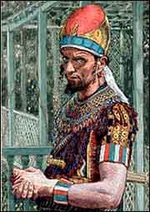
The Savior King
“Then he arose, took the young Child and His mother, and came into the land of Israel. But when he heard that Archelaus was reigning over Judea instead of his father
Herod, he was afraid to go
there.” (2:21-22a)
Notes:
Once he returns with the young Child and His mother, he then learns that one of the sons of Herod was ruling in Judea. Archelaus was another tyrannical villain, noted for murder and mental instability. Joseph was justified in his fear.

Slide 42
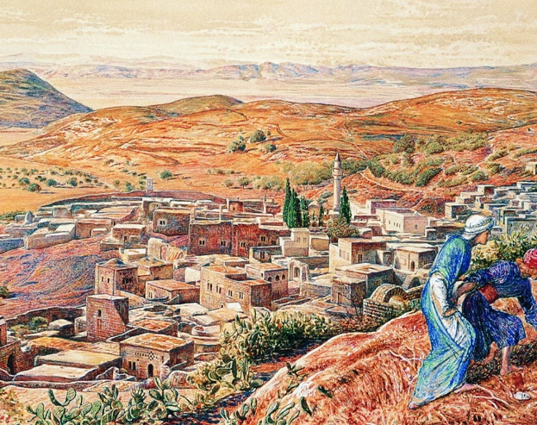
The Savior King
“And being warned by God in a dream, he turned aside into the region of Galilee. And he came and dwelt in a city called Nazareth, that it might be fulfilled which was spoken by the prophets, ‘He shall
be called a Nazarene.”
(2:22b-23)
Notes:
Therefore, God appears to him a forth time to redirects him to the region of Galilee. The ruler of the region was another of king Herod’s sons, but a more capable ruler.
Matthew states that this was to fulfill another prophecy, “the Anointed One”, “He will be called a Nazarene”.
Matthew does not make a direct quote from any OT text. ‘He uses the plural “prophets”, perhaps his idea was not based on a specific prophecy, but on the idea that appeared in a number of prophecies concerning Messiah’s despised character. To be called a Nazarene was a term of contempt.” (BKC, p. 23)
The term also fits several OT prophesies concerning his lowly character. Isaiah says that, “He has no stately form or majesty.” (53:2) [NASU]
“Matthew has in mind is Christ’s humble origins and background. He was know as being from honorable and prestigious Bethlehem, but from the contemptuous and lowly Nazareth (Mt. 26:71; Mk. 14:67; John 1:46; Acts 24:5) Christ’s beginnings were obscure and unimportant.” (GNT, p. 16) There are numerous OT prophecies state that Jesus’ would be despised, rejected and scorned.
The “Nazareth” is similar to a Hebrew word “neser” meaning “shoot, sprout, or branch” and then it refers to prophecies concerning the Messiah as a “shoot” of Jesse. “Then a shoot will spring from the stem of Jesse, and a branch from his roots will bear fruit.” (Isaiah 11:1) [NASU]
.

Slide 43
The Savior King
“Then a shoot will spring from the stem of Jesse, and a branch from his roots will bear fruit.” (Isaiah 11:1) [NASU]
Notes:
“Then a shoot will spring from the stem of Jesse, and a branch from his roots will bear fruit.” (Isaiah 11:1) [NASU]

Slide 44
The Savior King
Conclusion
Notes:
Nazareth was within the region of Zebulun and Naphtali, a land of contempt and darkness. It would be out of this dark land a great light would shine, “loves pure light” and He will make the land glorious. He will break the yoke of the burden and the staff on their shoulders, the rod of their oppressors will be lifted. The implements of war will be destroyed forever. And who is it that will do such a thing? It is the young Child that will be born, and the Son that will be given… and there will be no end to increase of His peace” (Isaiah 9:1-7)
This same Child is returning again to fulfill all the prophecies concerning Himself. The question is will you be a visitor who seeks to worship Him or a villain who seeks to destroy Him? I would suggest that you come and adore Him, the Savior King.

